Slide 1
Greedy Algorithms
Notes:
_{<number>}

Slide 2
Introduction
A greedy algorithm always makes the choice that looks best at the moment.
That is, it makes a locally optimal choice in the hope that this choice will lead to a globally optimal solution.
Notes:
_{<number>}

Slide 3


An activity selection problem
Suppose we have a set
of n proposed activities that wish to use a resource, such as a
lecture hall, which can be used by only one activity at a time.
Let s_{i} = start time for the activity a_{i}
f_{i}=finish time for the activity a_{i}
where
If selected, activity a_{i} takes place during the half interval [s_{i}, f_{i}).
Notes:
_{<number>}

Slide 4
An activity selection problem
a_{i} and a_{j} are competible if the intervals [s_{i}, f_{i}) and [s_{j}, f_{j}) do not overlap.
The activity-selection problem:
Select a maximum-size subset of mutually competible activities.
Notes:
_{<number>}

Slide 5
Interval Scheduling
Interval scheduling.
  Job j starts at s_{j} and finishes at f_{j}.
  Two jobs compatible if they don't overlap.
  Goal: find maximum subset of mutually compatible jobs.
a
b
c
d
e
f
g
h
Time
0
1
2
3
4
5
6
7
8
9
10
11
_{<number>}
Notes:
Activity selection = interval scheduling
OPT = B, E, H
Note: smallest job (C) is not in any optimal solution, job that starts first (A) is not in any optimal solution.

Slide 6
Interval Scheduling: Greedy Algorithms
Greedy template. Consider jobs in some order. Take each job provided it's compatible with the ones already taken.
  [Earliest start time] Consider jobs in ascending order of start time s_{j}.
  [Earliest finish time] Consider jobs in ascending order of finish time f_{j}.
  [Shortest interval] Consider jobs in ascending order of interval length f_{j} - s_{j}.
  [Fewest conflicts] For each job, count the number of conflicting jobs c_{j}. Schedule in ascending order of conflicts c_{j}.
_{<number>}

Slide 7
Interval Scheduling: Greedy Algorithms
Greedy template. Consider jobs in some order. Take each job provided it's compatible with the ones already taken.
_{breaks earliest start time}
_{breaks shortest interval}
_{breaks fewest conflicts}
_{<number>}

Slide 8
An example
Consider the following activities which are sorted in monotonically increasing order of finish time.
  i 1 2 3 4 5 6 7 8 9 10 11
  s_{i} 1 3 0 5 3 5 6 8 8 2 12
  f_{i} 4 5 6 7 8 9 10 11 12 13 14
We shall solve this problem in several steps
  Dynamic programming solution
  Greedy solution
  Recursive greedy solution
Notes:
_{<number>}

Slide 9
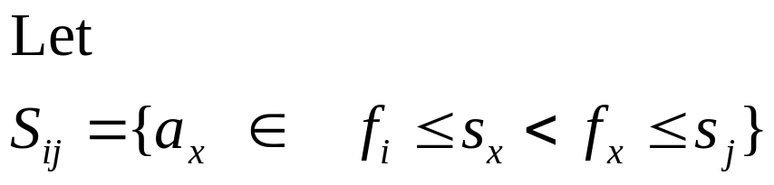
Dynamic programming solution
f_{i}
s_{x}
f_{x}
s_{j}
to be the subset of activities in S that can start after activity a_{i}
finishes and finish before activity a_{j} starts.
S_{ij} consists of all activities that are compatible with a_{i} and a_{j} and
are also compatible with all activities that finish no later than a_{i}
finishes and all activities that start no earlier than a_{j} starts.
Notes:
_{<number>}

Slide 10

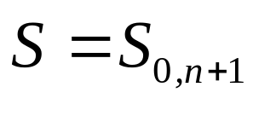

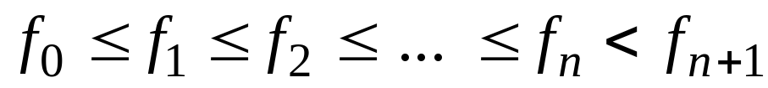

Dynamic programming solution (cont.)
Define
Then
And the ranges for i and j are given by
Assume that the activities are sorted in finish time such that
Also we claim that
Notes:
_{<number>}

Slide 11

Dynamic programming solution (cont.)
Assuming that we have sorted the activities in monotonically increasing
order of finish time, our space of subproblems is to select a maximum-size
subset of mutually compatible activities from S_{ij} for
knowing that all other S_{ij} are empty.
Notes:
_{<number>}

Slide 12
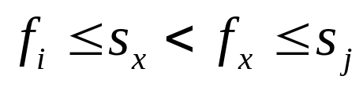
Dynamic programming solution (cont.)
Consider some non-empty subproblem S_{ij} , and suppose that a solution to S_{ij} includes some activity a_{x}, so that
Using activity a_{x}, generates two subproblems: S_{ix} and S_{xj} .
Our solution to S_{ij} is the union of the solutions to S_{ix} and S_{xj} along with the activity a_{x} .
Thus, the # activities in our solution to S_{ij} is the size of solution to S_{ix} plus the size of solution to S_{xj} plus 1 for a_{x} .
S_{ix}
a_{x}
S_{xj}
s_{x}
f_{x}
s_{j}
f_{i}
Notes:
_{<number>}

Slide 13
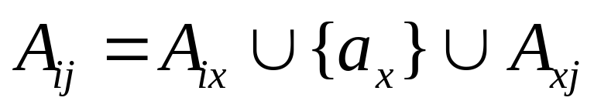
Dynamic programming solution (cont.)
Let A_{ij} be the solution to S_{ij}. Then, we have
An optimal solution to the entire problem is a solution to S_{0,n+1}.
Notes:
_{<number>}

Slide 14
A recursive solution
The second step in developing a dynamic-programming solution is to recursively define the value of an optimal solution.
Let c[ i, j] be the # activities in a maximum-size subset of mutuall compatible activities in S_{ij}. Based on the definition of A_{ij} we can write the following recurrence
c[ i, j] = c[ i, x] + c[ x, j] +1
This recursive equation assumes that we know the value of x.
Notes:
_{<number>}

Slide 15
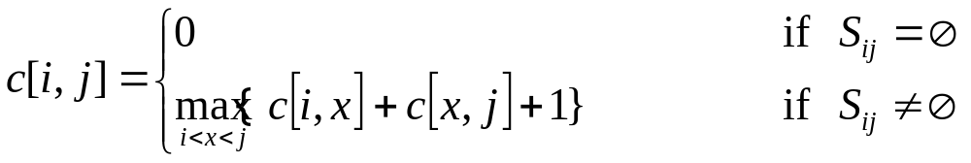
A recursive solution (cont.)
There are j - i-1 possible values of x namely x= i+1, ..., j-1.
Thus, our full recursive defination of c[ i, j] becomes
Notes:
_{<number>}

Slide 16
A bottom-up dynamic-programming solution
It is straightforward to write a tabular, bottom-up dynamic-programming algorithm based on the above recurrence
Notes:
_{<number>}

Slide 17
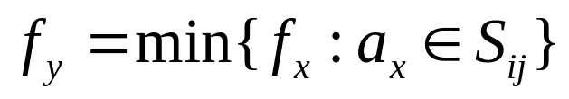
Converting a dynamic-programming solution to a greedy
Theorem:
Consider any nonempty subproblem S_{ij} with the earliest finish time . Then
1. Activity a_{y} is used in some maximum-size subset of mutually competible activities of S_{ij .}
2.The subproblem S_{iy} is empty, so that choosing a_{y} leaves the subproblem S_{yj} as the only one that may be nonempty
Notes:
_{<number>}

Slide 18
Converting a dynamic-programming solution to a greedy (cont.)
Important results of the Theorem:
1.In our dynamic-programming solution there were j-i-1 choices when solving S_{ij}. Now, we have one choice and we need consider only one choice: the one with the earliest finish time in S_{ij.} (The other subproblem is guaranteed to be empty)
2. We can solve each problem in a top-down fashion rather than the bottom-up manner typically used in dynamic programming.
Notes:
_{<number>}

Slide 19
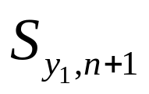
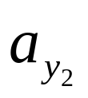
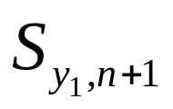
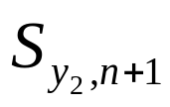
Converting a dynamic-programming solution to a greedy (cont.)
We note that there is a pattern to the subproblems that we solve:
1. Our original problem S = S_{0,n+1}.
2. Suppose we choose a_{y1} as the activity
(in this case y₁ = 1 ).
3. Our next sub-problem is and we choose as the activity in with the earliest finish time.
4. Our next sub problem is for some activity number y₂. ...etc.
Notes:
_{<number>}

Slide 20
Recursive greedy algorithm
RECURSIVE-ACTIVITY-SELECTOR(s, f, i, j)
1 y ← i+1
2 while y < j and s_{y} < f_{i} (Find the first activity)
3 do y ← y+1
if y < j
then return {a_{y}}U RECURSIVE-ACTIVITY- SELECTOR(s, f, y, j)
else return Ø
The initial call is
RECURSIVE-ACTIVITY-SELECTOR(s, f, 0, n+1)
Notes:
_{<number>}

Slide 21
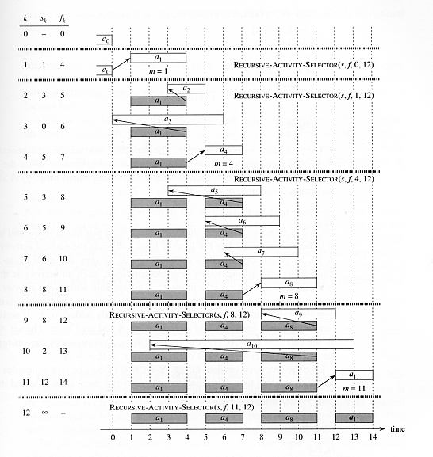
Recursive Greedy Algorithm
RECURSIVE-ACTIVITY-SELECTOR(s, f, i, j)
1 y ← i+1
2 while y < j and s_{y} < f_{i}
3 do y ← y+1
4 if y < j
5 then return{a_{y}}URECUR SIVE-ACTIVITY SELECTOR(s, f, y, j)
6 else return Ø
Notes:
_{<number>}

Slide 22
Iterative greedy algorithm
We easily can convert our recursive procedure to an iterative one.
The following code is an iterative version of the procedure RECURSIVE-ACTIVITY-SELECTOR.
It collects selected activities into a set A and returns this set when it is done.
Notes:
_{<number>}

Slide 23
Iterative greedy algorithm
GREEDY-ACTIVITY-SELECTOR(s, f)
1 n ← lengths[s]
A←{ a₁}
i←1
for y ← 2 to n
do if s_{y} ≥ f_{i}
then A←A U { a_{y}}
i←y
return A
Notes:
_{<number>}

Slide 24
Elements of greedy strategy
Determine the optimal substructure of the problem.
Develop a recursive solution
Prove that any stage of recursion, one of the optimal choices is greedy choice.
Show that all but one of the subproblems induced by having made the greedy choice are empty.
Develop a recursive algorithm that implements the greedy strategy.
Convert the recursive algorthm to an iterative algorithm.
Notes:
_{<number>}

Slide 25
Greedy choice property
A globally optimal solution can be arrived at by making a locally optimal(greedy) choice.
When we are considering which choice to make, we make the choice that looks best in the current problem, without considering results from subproblems
Notes:
_{<number>}

Slide 26
Greedy choice property (cont.)
In dynamic programming, we make a choice at each step, but the choice usually depends on the solutions to subproblems.
We typically solve dynamic-programming problems in a bottom-up manner.
In a greedy algorithm, we make whatever choice seems best at the moment and then solve the subproblem arising after the choice is made.
A greedy strategy usually progresses in a top-down fashion, making one greedy choice after another.
Notes:
_{<number>}

Slide 27
The 0-1 knapsack problem
A thief robbing a store finds n items; the ith item worths v_{i} dollars and weighs w_{i} pounds, where v_{i} and w_{i} are integers.
He wants to take as valuable a load as possible, but he can carry at most W pounds in his knapsack for some integer W.
Which item should he take?
Notes:
_{<number>}

Slide 28
The fractional knapsack problem
The set up is the same, but the thief can take fractions of items, rather than having to make a binary (0-1) choice for each item.
Notes:
_{<number>}

Slide 29
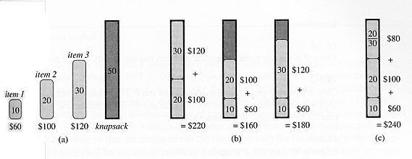
The knapsack problem
Notes:
_{<number>}

Slide 30
Huffman codes
Huffman codes are widely used and very effective technique for compressing data.
We consider the data to be a sequence of charecters.
Notes:
_{<number>}

Slide 31
Huffman codes (cont.)
 | a | b | c | d | e | f
Frequency(in thousands) | 45 | 13 | 12 | 16 | 9 | 5
Fixed-length codeword | 000 | 001 | 010 | 011 | 100 | 101
Variable-length codeword | 0 | 101 | 100 | 111 | 1101 | 1100
A charecter coding problem:
Fixed length code requires 300 000 bits to code
Variable-length code requires 224 000 bits to code
Notes:
_{<number>}

Slide 32
Huffman codes (cont.)
₁₀₀
₁₀₀
₀
₁
₀
₁
_{a:45}
₅₅
₁₄
_{a:45}
₈₆
₀
₀
₀
₁
₁
₅₈
₂₈
₁₄
₂₅
₃₀
₀
₁
₀
₁
₀
₁
₀
₁
₀
₁
_{a:45}
b:13
_{d:16}
_{c:12}
_{d:16}
_{e:9}
_{f:5}
_{c:12}
b:13
₁₄
_{d:16}
₀
₁
_{f:5}
_{e:9}
_{Fixed-length code}
_{Variable-length code}
Notes:
_{<number>}

Slide 33

Huffman codes (cont.)
Prefix code: Codes in which no codeword is also a prefix of some other codeword.
Encoding for binary code:
Example: Variable-length prefix code.
a b c
Decoding for binary code:
Example: Variable-length prefix code.
Notes:
_{<number>}

Slide 34
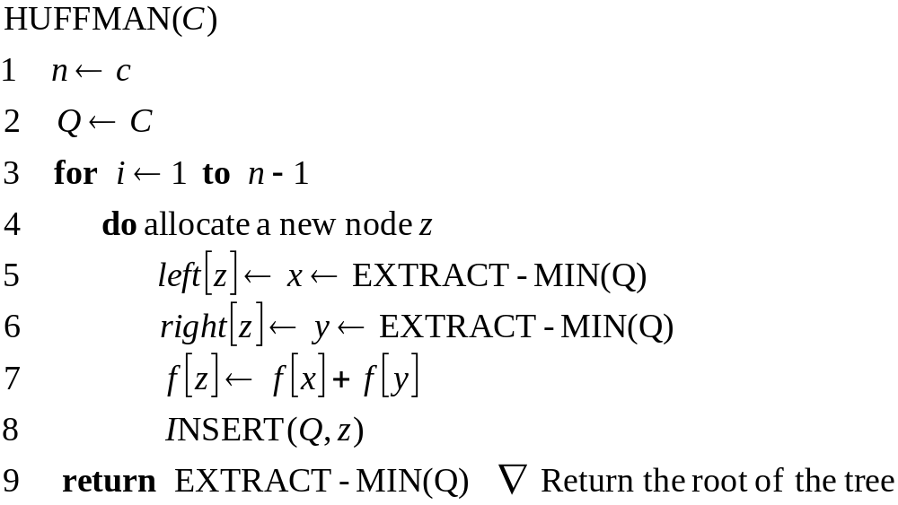
Constructing Huffman codes
Notes:
_{<number>}

Slide 35
Constructing Huffman codes
Huffman’s algorithm assumes that Q is implemented as a binary min-heap.
Running time:
Line 2 : O(n) (uses BUILD-MIN-HEAP)
Line 3-8: O(n lg n) (the for loop is executed exactly n-1 times and each heap operation requires time O(lg n) )
Notes:
_{<number>}

Slide 36
Constructing Huffman codes: Example
f:5
e:9
c:12
b:13
d:16
a:45
c:12
b:13
14
d:16
a:45
0
1
0
f:5
e:9
14
d:16
25
a:45
0
1
0
0
1
f:5
e:9
c:12
b:13
Notes:
_{<number>}

Slide 37
Constructing Huffman codes: Example
25
30
a:45
0
1
0
1
c:12
b:13
14
d:16
0
1
f:5
e:9
Notes:
_{<number>}

Slide 38
Constructing Huffman codes: Example
55
a:45
1
0
25
30
0
1
0
1
c:12
b:13
14
d:16
0
1
f:5
e:9
Notes:
_{<number>}

Slide 39
Constructing Huffman codes: Example
100
0
1
a:45
55
0
1
25
30
0
1
0
1
c:12
b:13
14
d:16
0
1
f:5
e:9
Notes:
_{<number>}

Slide 40

Coin Changing
Greed is good. Greed is right. Greed works. Greed clarifies, cuts through, and captures the essence of the evolutionary spirit.
- Gordon Gecko (Michael Douglas)
Notes:
"michael douglas played gordon gecko in iconic movie of the 1980's that embodied Reagan era"
also starring charlie and martin sheen, directed by Oliver Stone

Slide 41





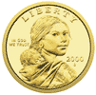

Coin Changing
Goal. Given currency denominations: 1, 5, 10, 25, 100, devise a method to pay amount to customer using fewest number of coins.
Ex: 34¢.
Cashier's algorithm. At each iteration, add coin of the largest value that does not take us past the amount to be paid.
Ex: $2.89.
Notes:
most of us solve this kind of problem every day without thinking twice, unconsciously using an obvious greedy algorithm
http://www.frbatlanta.org/publica/brochure/fundfac/html/coinfaces.html

Slide 42
Coin-Changing: Greedy Algorithm
Cashier's algorithm. At each iteration, add coin of the largest value that does not take us past the amount to be paid.
Q. Is cashier's algorithm optimal?
Sort coins denominations by value: c₁ < c₂ < … < c_{n}.
S ← φ
while (x ≠ 0) {
let k be largest integer such that c_{k} ≤ x
if (k = 0)
return "no solution found"
x ← x - c_{k}
S ← S ∪ {k}
}
return S
_{coins selected}
Notes:
takes O(n log n) + |S| where S is the number of coins taken by greedy
Note: can be sped up somewhat by using integer division

Slide 43
Coin-Changing: Analysis of Greedy Algorithm
Theorem. Greed is optimal for U.S. coinage: 1, 5, 10, 25, 100.
Pf. (by induction on x)
  Consider optimal way to change c_{k} ≤ x < c_{k+1} : greedy takes coin k.
  We claim that any optimal solution must also take coin k.
    if not, it needs enough coins of type c₁, …, c_{k-1} to add up to x
    table below indicates no optimal solution can do this
  Problem reduces to coin-changing x - c_{k} cents, which, by induction, is optimally solved by greedy algorithm. ▪
k
c_{k}
All optimal solutions
must satisfy
Max value of coins
1, 2, …, k-1 in any OPT
1
1
P ≤ 4
-
2
5
N ≤ 1
4
3
10
N + D ≤ 2
4 + 5 = 9
4
25
Q ≤ 3
20 + 4 = 24
5
100
no limit
75 + 24 = 99
Notes:
P = pennies, N = nickels, D = dimes, Q = quarters

Slide 44
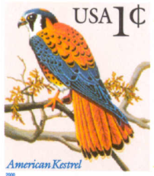
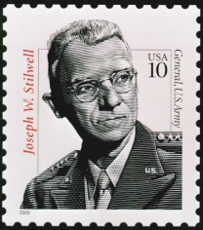
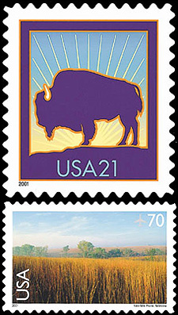
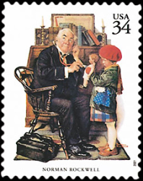


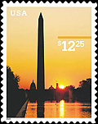
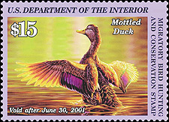
Coin-Changing: Analysis of Greedy Algorithm
Observation. Greedy algorithm is sub-optimal for US postal
denominations: 1, 10, 21, 34, 70, 100, 350, 1225, 1500.
Counterexample. 140¢.
  Greedy: 100, 34, 1, 1, 1, 1, 1, 1.
  Optimal: 70, 70.
Notes:
note: may not even lead to *feasible* solution if c_1 > 1!
Ex. C = {7, 8, 9}, x = 15

